Slide 1
3D Game Basic
16th class
Positions, Movement and Navigation for Character GameObjects
Handityo aulia putra

Slide 2
Positions, Movement and Navigation for Character GameObjects
Many GameObjects in games move!
Movement can be controlled by
the player,
The (simulated) laws of physics in the environment,
The Non-Player Character (NPC) logic.
For example,
objects that follow a path of waypoints,
seek (move towards)
flee (away) from the current position of a character.

Slide 3
Positions, Movement and Navigation for Character GameObjects
Unity provides several controllers,
for first and third-person characters,
for vehicles such as cars and airplanes.
GameObject movement can also be controlled through the state machines of the Unity Mecanim animation system.

Slide 4
Positions, Movement and Navigation for Character GameObjects
There maybe times when you wish to
tweak the Player character controllers from Unity,
write your own movement.
You might wish to write directional logic—
simple or sophisticated Artificial Intelligence (AI) to control the game's NPC and enemy characters.

Slide 5
Positions, Movement and Navigation for Character GameObjects
Unity provides sophisticated classes and components
Vector3 class
Rigid body physics
These can be used for modeling
realistic movements,
forces,
collisions in games.
We make use of these game engine features to implement some sophisticated NPC and enemy character movements in the recipes of this chapter.

Slide 6
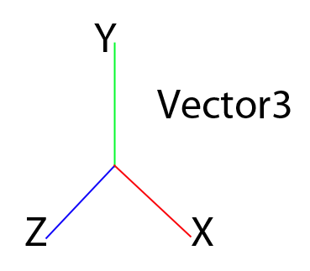
Positions, Movement and Navigation for Character GameObjects
Vector3 class
A fundamental class of object for 3D games (and to some extent, 2D games as well)
An object that store and manipulate (x,y,z) values representing locations in 3D space.
If we draw an imaginary arrow from the origin (0,0,0) to a point on space, then the direction and length of this arrow (vector) can represent a velocity or force (that is, a certain amount of magnitude in a certain direction).

Slide 7
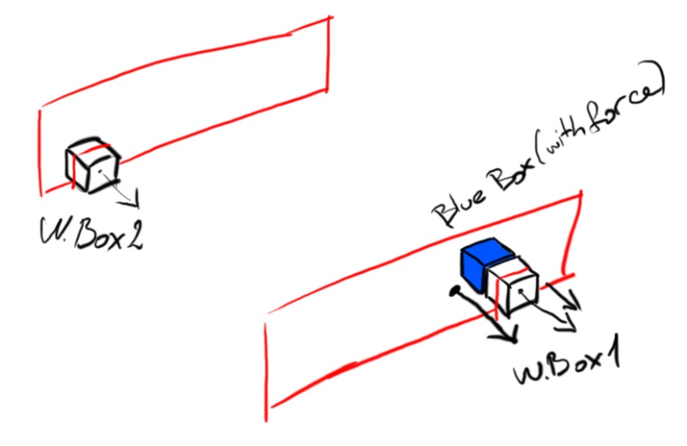
Positions, Movement and Navigation for Character GameObjects
If we ignore all the character controller components, colliders, and the physics system in Unity,
we can write code that teleports objects directly to a particular (x, y, z) location in our scene.

Slide 8
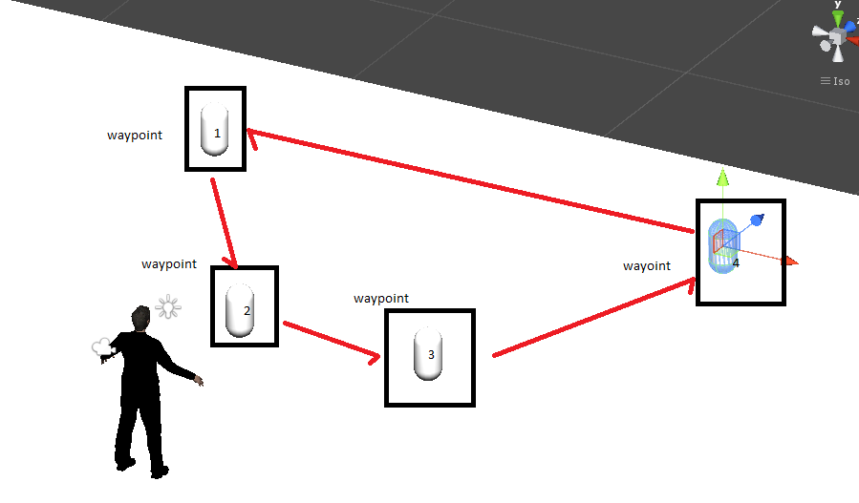
Positions, Movement and Navigation for Character GameObjects
If we want objects to move in more physically realistic ways,
apply a force to the object,
change its velocity component.
If it has a Character Controller component,
we can send it a Move() message.
With the introduction of Unity NavMeshAgents (and associated Navigation Meshes),
we can now set a destination for an object with a NavMeshAgent, and then the built-in pathfinding logic will do the work of moving our NPC object on a path towards the given (x, y, z) destination location.

Slide 9
Positions, Movement and Navigation for Character GameObjects
In addition to decide which technique will be used to move an object, it is necessary to decide
how to choose the destination locations,
the direction and magnitude of changes to movement.
This can involve logic to tell an NPC or enemy object the destination of the Player's character
(to be moved towards, and then perhaps attacked when close enough).

Slide 10
Positions, Movement and Navigation for Character GameObjects
Core movement concept:
Spawn points
Specific locations in the scene where objects are to be created, or moved to
Waypoints
The sequence of locations to define a path for NPCs or perhaps, the Player's character to follow
Checkpoints
Locations (or colliders) that, once passed through, change what happens in the game (for example, extra time, or if a Player's character gets killed, they respawn to the last crossed checkpoint, and so on)

Slide 11
Player control of a 2D GameObject
limiting the movement within a rectangle

Slide 12
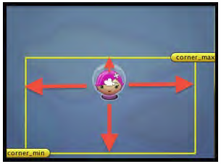
Limiting the movement within a rectangle

Slide 13
Limiting the movement within a rectangle : Preparation
Import Assets:
A Unity Package: Simple2DGame_SpaceGirl

Slide 14
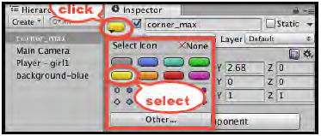
Limiting the movement within a rectangle
1. Create a new empty GameObject
named corner_max, and
position it somewhere above and to the right of the GameObject called Player-girl1.
With this GameObject selected in the Hierarchy view,
choose the large yellow oblong icon, highlighted in the Inspector panel.

Slide 15
Limiting the movement within a rectangle
2. Duplicate the corner_max GameObject
naming the clone as corner_min,
position this clone somewhere below and to the left of the player-spaceGirl1 GameObject.
The coordinates of these two GameObjects will determine the maximum and minimum bounds of movement, permitted for the player's character.

Slide 16
Limiting the movement within a rectangle
3. Modify the C# Script called PlayerMove to declare some new variables at the beginning of the class:
public Transform corner_max;
public Transform corner_min;
private float x_min;
private float y_min;
private float x_max;
private float y_max;

Slide 17
Limiting the movement within a rectangle
4. Modify the C# Script called PlayerMove so that
the Awake() method now gets a reference to the SpriteRenderer, and
uses this object to help setup the maximum and minimum X and Y movement limits:
void Awake()
{
rigidBody2D = GetComponent<Rigidbody2D>();
x_max = corner_max.position.x;
x_min = corner_min.position.x;
y_max = corner_max.position.y;
y_min = corner_min.position.y;
}

Slide 18
Limiting the movement within a rectangle
5. Modify the C# Script called PlayerMove to declare a new method called KeepWithinMinMaxRectangle():
private void KeepWithinMinMaxRectangle()
{
float x = transform.position.x;
float y = transform.position.y;
float z = transform.position.z;
float clampedX = Mathf.Clamp(x, x_min, x_max);
float clampedY = Mathf.Clamp(y, y_min, y_max);
transform.position = new Vector3(clampedX, clampedY, z);
}

Slide 19
Limiting the movement within a rectangle
6. Modify the C# Script called PlayerMove so that,
after having done everything else in the FixedUpdate()method,
a call will finally be made to the KeepWithinMinMaxRectangle() method:
void FixedUpdate(){
float xMove = Input.GetAxis("Horizontal");
float yMove = Input.GetAxis("Vertical");
float xSpeed = xMove * speed;
float ySpeed = yMove * speed;
Vector2 newVelocity = new Vector2(xSpeed, ySpeed);
rigidBody2D.velocity = newVelocity;
// restrict player movement
KeepWithinMinMaxRectangle();
}

Slide 20
Limiting the movement within a rectangle
7. With the player-SpaceGirl1 GameObject in the Hierarchy view,
drag the corner_max and corner_min GameObjects over the public variables called corner_max and corner_min in the Inspector.

Slide 21
Limiting the movement within a rectangle
8. Before running the scene in the Scene panel,
try repositioning the corner_max and corner_min GameObjects.
When you run the scene,
the positions of these two GameObjects (max and min, and X and Y) will be used as the limits of movement for the Player's player-SpaceGirl1 character.

Slide 22
Limiting the movement within a rectangle
9. While all this works fine,
let's make the rectangular bounds of the movement visually explicit in the Scene panel
by having a yellow "gizmo" rectangle drawn.
Add the following method to the C# script class called PlayerMove:
void OnDrawGizmos(){
Vector3 top_right = Vector3.zero; Vector3 bottom_right = Vector3.zero;
Vector3 bottom_left = Vector3.zero;
Vector3 top_left = Vector3.zero;
if(corner_max && corner_min){
top_right = corner_max.position;
bottom_left = corner_min.position;
bottom_right = top_right;
bottom_right.y = bottom_left.y;
top_left = top_right;
top_left.x = bottom_left.x;
}
//Set the following gizmo colors to YELLOW
Gizmos.color = Color.yellow;
//Draw 4 lines making a rectangle
Gizmos.DrawLine(top_right, bottom_right);
Gizmos.DrawLine(bottom_right, bottom_left);
Gizmos.DrawLine(bottom_left, top_left);
Gizmos.DrawLine(top_left, top_right);
}

Slide 23
Limiting the movement within a rectangle - How
We added the empty GameObjects called corner_max and corner_min to the scene.
The X and Y- coordinates of these GameObjects will be used to determine the bounds of movement that we will permit for the character called player-SpaceGirl1.
Since these are the empty GameObjects, they will not be seen by the player when in the play-mode.
However, we can see and move them in the Scene panel, and having added the yellow oblong icons, we can see their positions and names very easily.

Slide 24
Limiting the movement within a rectangle - How
Upon Awake() the PlayerMoveWithLimits object,
records the maximum and minimum X- and Y- values of the GameObjects called corner_max and corner_min inside the player-SpaceGirl1 GameObject.
Each time the physics system is called via the FixedUpdate() method,
the velocity of the player-SpaceGirl1 character is set according to the horizontal and vertical keyboard/joystick inputs.
However, the final action of the FixedUpdate() method is to call the KeepWithinMinMaxRectangle() method,
which uses the Math.Clamp(…) function to move the character back inside the X- and Y- limits.
This happens so that the player's character is not permitted to move outside the area defined by the corner_max and corner_min GameObjects.

Slide 25
Update Order
In addition to Unity Update() method which is called one per frame, there are two other Update in Unity:
LateUpdate
FixedUpdate

Slide 26
Update Order
LateUpdate():
Called once per frame, after Update has finished.
Any calculations that are performed in Update will have completed when LateUpdate begins.
A common use for LateUpdate would be a following third-person camera.
If you make your character move and turn inside Update, you can perform all camera movement and rotation calculations in LateUpdate.
This will ensure that the character has moved completely before the camera tracks its position.

Slide 27
Update Order
FixedUpdate:
FixedUpdate is often called more frequently than Update.
It can be called multiple times per frame, if the frame rate is low,
it may not be called between frames at all if the frame rate is high.
All physics calculations and updates occur immediately after FixedUpdate.
When applying movement calculations inside FixedUpdate, you do not need to multiply your values by Time.deltaTime.
This is because FixedUpdate is called on a reliable timer, independent of the frame rate.

Slide 28
Player control of a 3D GameObject
limiting the movement within a rectangle

Slide 29
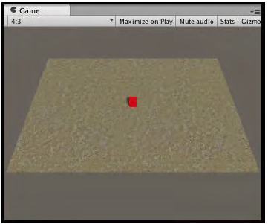
Limiting the movement within a rectangle (3D)
The bounds of movement of the cube are constrained using the same technique as in the previous 2D recipe.

Slide 30
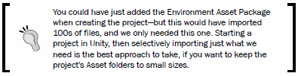
Limiting the movement within a rectangle (3D)
1. Create a new, empty 3D project.
2. Once the project has been created,
import the single Terrain Texture named SandAlbedo (it was named GoodDirt in Unity 4).
Choose menu: Assets | Import Package | Environments,
deselect everything, and then locate and tick the asset: Assets/Environment/TerrainAssets/SurfaceTextures/SandAlbedo.psd.

Slide 31
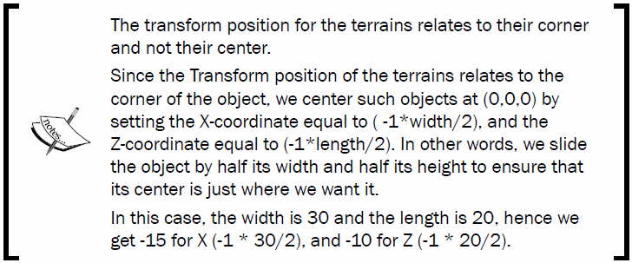
Limiting the movement within a rectangle (3D)
3. Create a terrain positioned at (-15, 0, -10) and sized 30 by 20.

Slide 32
Limiting the movement within a rectangle (3D)
4. Texture paint this terrain with your texture called SandAlbedo.
5. Create a directional light
(it should face downwards to the terrain with the default settings—but if it doesn't for some reason, then rotate it so that the terrain is well lit).

Slide 33

Limiting the movement within a rectangle (3D)
6. Make the following changes to the Main Camera:
7. Change the Aspect Ratio of the Game Panel from Free Aspect to 4:3.
You will now see the whole of the Terrain in the Game Panel.

Slide 34
Limiting the movement within a rectangle (3D)
8. Create a new empty GameObject
named corner_max, and
position it at (14, 0, 9).
With this GameObject selected in the Hierarchy,
choose the large, yellow oblong icon, highlighted in the Inspector panel.

Slide 35
Limiting the movement within a rectangle (3D)
9. Duplicate the corner_max GameObject,
naming the clone as corner_min, and
position this clone at (-14, 0, -9).
The coordinates of these two GameObjects will determine the maximum and minimum bounds of the movement permitted for the player's character.

Slide 36
Limiting the movement within a rectangle (3D)
10. Create a new Cube GameObject
named Cube-player
position it at (0, 0.5, 0), and
size it as (1,1,1).
11. Add to the Cube-player GameObject,
apply a component called Physics | RigidBody, and
uncheck the RigidBody property Use Gravity.
12. Create a red Material
named m_red, and
apply this Material to Cube-player.

Slide 37
Limiting the movement within a rectangle (3D)
13. Add the following C# script class called PlayerControl to the Cube-player:
using UnityEngine;
using System.Collections;
public class PlayerControl : MonoBehaviour {
public Transform corner_max;
public Transform corner_min;
public float speed = 40;
private Rigidbody rigidBody;
private float x_min;
private float x_max;
private float z_min;
private float z_max;
void Awake (){
rigidBody = GetComponent<Rigidbody>();
x_max = corner_max.position.x;
x_min = corner_min.position.x;
z_max = corner_max.position.z;
z_min = corner_min.position.z;
}
void FixedUpdate() {
KeyboardMovement();
KeepWithinMinMaxRectangle();
}
private void KeyboardMovement (){
float xMove = Input.GetAxis("Horizontal") * speed * Time.
deltaTime;
float zMove = Input.GetAxis("Vertical") * speed * Time.
deltaTime;
float xSpeed = xMove * speed;
float zSpeed = zMove * speed;
Vector3 newVelocity = new Vector3(xSpeed, 0, zSpeed);
rigidBody.velocity = newVelocity;
// restrict player movement
KeepWithinMinMaxRectangle ();
}
private void KeepWithinMinMaxRectangle (){
float x = transform.position.x;
float y = transform.position.y;
float z = transform.position.z;
float clampedX = Mathf.Clamp(x, x_min, x_max);
float clampedZ = Mathf.Clamp(z, z_min, z_max);
transform.position = new Vector3(clampedX, y, clampedZ);
}
void OnDrawGizmos (){
Vector3 top_right = Vector3.zero;
Vector3 bottom_right = Vector3.zero;
Vector3 bottom_left = Vector3.zero;
Vector3 top_left = Vector3.zero;
if(corner_max && corner_min){
top_right = corner_max.position;
bottom_left = corner_min.position;
bottom_right = top_right;
bottom_right.z = bottom_left.z;
top_left = bottom_left;
top_left.z = top_right.z;
}
//Set the following gizmo colors to YELLOW
Gizmos.color = Color.yellow;
//Draw 4 lines making a rectangle
Gizmos.DrawLine(top_right, bottom_right);
Gizmos.DrawLine(bottom_right, bottom_left);
Gizmos.DrawLine(bottom_left, top_left);
Gizmos.DrawLine(top_left, top_right);
}
}

Slide 38
Limiting the movement within a rectangle (3D)
14. With the Cube-player GameObject selected in the Hierarchy,
drag the GameObjects called corner_max and corner_min over the public variables called corner_max and corner_min in the Inspector panel.
15. When you run the scene,
the positions of the corner_max and corner_min GameObjects will define the bounds of movement for the Player's Cube-player character.

Slide 39
Limiting the movement within a rectangle (3D) - How
The scene contains a positioned terrain so that its center is (0,0,0).
The red cube is controlled by the user's arrow keys through the PlayerControl script.

Slide 40
Limiting the movement within a rectangle (3D) - How
Just as with the previous 2D recipe,
a reference to the (3D) RigidBody component is stored when the Awake() method executes, and
the maximum and minimum X- and Z- values are retrieved from the two corner GameObjects, and is stored in the x_min, x_max, z_min, and z_max variables.

Slide 41
Limiting the movement within a rectangle (3D) - How
Note that
for this basic 3D game, we won't allow any Y-movement,
such movement can be easily added by extending the code in this recipe
(by adding a third 'max-height' corner GameObject).

Slide 42
Limiting the movement within a rectangle (3D) - How
The KeyboardMovement() method
reads the horizontal and vertical input values
(which the Unity default settings read from the four directional arrow keys).
Based on these left-right and up-down values, the velocity of the cube is updated.
The amount it will move depends on the speed variable.

Slide 43
Limiting the movement within a rectangle (3D) - How
The KeepWithinMinMaxRectangle() method
uses the Math.Clamp(…) function to move the character back inside the X and Z limits,
so that the player's character is not permitted to move outside the area defined by the corner_max and corner_min GameObjects.

Slide 44
Limiting the movement within a rectangle (3D) - How
The OnDrawGizmos() method
tests that the references to the corner_max and corner_min GameObjects are not null,
sets the positions of the four Vector3 objects,
representing the four corners defined by the rectangle with the corner_max and corner_min GameObjects at the opposite corners.
It then sets the Gizmo color to yellow, and draws lines connecting the four corners in the Scene panel.

Slide 45
MonoBehaviour.OnDrawGizmos()
Implement OnDrawGizmos if you want to draw gizmos that are also pickable and always drawn.
This allows you to quickly pick important objects in your scene. Note that OnDrawGizmos will use a mouse position that is relative to the Scene View. This function does not get called if the component is collapsed in the inspector.

Slide 46
Choosing destinations
find the nearest (or a random) spawn point

Slide 47
Choosing destinations
This project demonstrates two very common examples of spawning—
the choosing of either a random spawn point, or the nearest one to an object of interest (such as the Player's character),
the instantiation of an object at that chosen point.

Slide 48
Choosing destinations
1. Create a Sphere
sized as (1,1,1) at
position (2,2,2), and
apply the m_red Material.
2. Create a new Prefab named Prefab-ball, and drag the Sphere into it
(and then delete the Sphere from the Hierarchy panel).

Slide 49

Choosing destinations
3. Create a new capsule object
named Capsule-spawnPoint at
position (3, 0.5, 3),
give it the tag as Respawn
(this is one of the default tags that Unity provides).

Slide 50
Choosing destinations
4. Make several copies of your Capsule-spawnPoint by moving them to different locations on the terrain.
5. Add an instance of the following C# script class called SpawnBall to the Cube-the player GameObject:
using UnityEngine;
using System.Collections;
public class SpawnBall : MonoBehaviour {
public GameObject prefabBall;
private SpawnPointManager spawnPointManager;
private float destroyAfterDelay = 1; private float testFireKeyDelay = 0;
void Start (){
spawnPointManager = GetComponent<SpawnPointManager> ();
StartCoroutine("CheckFireKeyAfterShortDelay");
}
IEnumerator CheckFireKeyAfterShortDelay () {
while(true){
yield return new WaitForSeconds(testFireKeyDelay);
// having waited, now we check every frame
testFireKeyDelay = 0;
CheckFireKey();}
}
private void CheckFireKey() {
if(Input.GetButton("Fire1")){
CreateSphere();
// wait half-second before alling next spawn
testFireKeyDelay = 0.5f;}
}
private void CreateSphere(){
GameObject spawnPoint = spawnPointManager.RandomSpawnPoint ();
GameObject newBall = (GameObject)Instantiate (prefabBall,
spawnPoint.transform.position, Quaternion.identity);
Destroy(newBall, destroyAfterDelay);}
}

Slide 51
Choosing destinations
6. Add an instance of the following C# script class called SpawnPointManager to the Cube-player GameObject:
using UnityEngine;
using System.Collections;
public class SpawnPointManager : MonoBehaviour {
private GameObject[] spawnPoints;
void Start() {
spawnPoints = GameObject.FindGameObjectsWithTag("Respawn");
}
public GameObject RandomSpawnPoint (){
int r = Random.Range(0, spawnPoints.Length);
return spawnPoints[r];
}
}

Slide 52
Choosing destinations
7. Ensure that Cube-player is selected in the Inspector for the SpawnBall scripted component.
Then, drag Prefab-ball over the public variable projectile called Prefab Ball.
8. Now, run your game.
When you click on the mouse (fire) button,
a sphere will be instantiated randomly to one of the capsule locations.

Slide 53
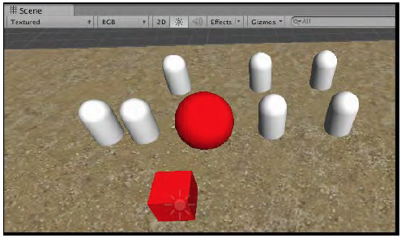
Choosing destinations

Slide 54
Choosing destinations - How
When the SpawnBall object GameObject Cube-player receives the Start() message,
it sets the spawnPointManager variable to be a reference to its sibling SpawnPointManager script component.
Next, the coroutine method is started CheckFireKeyAfterShortDelay().

Slide 55
Choosing destinations - How
The CheckFireKeyAfterShortDelay() method
uses a typical Unity coroutine technique that goes into an infinite loop using a delay controlled by the value of the testFireKeyDelay variable.
The delay is to make Unity wait before calling CheckFireKey() to test if the user wants a new sphere to be spawned.

Slide 56
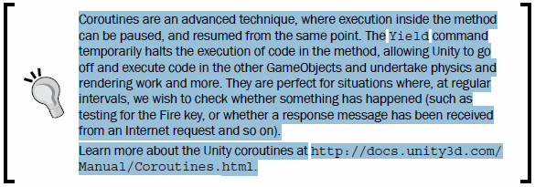
Choosing destinations - How
Coroutines are an advanced technique, where execution inside the method
can be paused, and resumed from the same point.
The Yield command temporarily halts the execution of code in the method, allowing Unity to go off and execute code in the other GameObjects and undertake physics and rendering work and more.
They are perfect for situations where, at regular intervals, we wish to check whether something has happened (such as testing for the Fire key, or whether a response message has been received from an Internet request and so on).
Learn more about the Unity coroutines at http://docs.unity3d.com/Manual/Coroutines.html.

Slide 57
Choosing destinations - How
The SpawnBall method CheckFireKey()
tests whether, at that instant, the user is pressing the Fire button.
If the Fire button is pressed, then the CreateSphere()method is called.
Also, the testFireKeyDelay variable is set to 0.5.
This ensures that we won't test the Fire button again for half a second.

Slide 58
Choosing destinations - How
The SpawnBall method CreateSphere()
assigns variable spawnPoint to the GameObject returned by a call to the RandomSpawnpoint(…) method of the spawnPointManager.
Then it creates a new instance of prefab_Ball (via the public variable) at the same position as the spawnPoint GameObject.

Slide 59
Choosing destinations – Nearest Spawn Point
Project 3 modification

Slide 60
Choosing destinations – Nearest Spawn Point
To find the nearest spawn point, we need to do the following:
1. Add the following method to the C# script class called SpawnPointManager:
public GameObject NearestSpawnpoint (Vector3 source)
{
GameObject nearestSpawnPoint = spawnPoints[0];
Vector3 spawnPointPos = spawnPoints[0].transform.position;
float shortestDistance = Vector3.Distance(source,
spawnPointPos);
for (int i = 1; i < spawnPoints.Length; i++){
spawnPointPos = spawnPoints[i].transform.position;
float newDist = Vector3.Distance(source, spawnPointPos);
if (newDist < shortestDistance){
shortestDistance = newDist;
nearestSpawnPoint = spawnPoints[i];}
}
return nearestSpawnPoint;
}

Slide 61
Choosing destinations – Nearest Spawn Point
2. We now need to change the first line in the C# class called SpawnBall so that the spawnPoint variable is set by a call to our new method called NearestSpawnpoint(…):
private void CreateSphere()
{
GameObject spawnPoint = spawnPointManager.
NearestSpawnpoint(transform.position);
GameObject newBall = (GameObject)Instantiate (prefabBall,
spawnPoint.transform.position, Quaternion.identity);
Destroy(newBall, lifeDuration);
}

Slide 62
Choosing destinations – Nearest Spawn Point
In the NearestSpawnpoint(…) method, we set nearestSpawnpoint to the first (array index 0) GameObject in the array as our default.
We then loop through the rest of the array
(array index 1 up to spawnPoints.Length).
For each GameObject in the array, we test to see if its distance is less than the shortest distance so far, and if it is, then we update the shortest distance, and also set nearestSpawnpoint to the current element.
When the array has been searched, return the GameObject that the nearestSpawnpoint variable refers to.

Slide 63
Choosing destinations – Avoiding errors due to an empty array
To cope with the no objects tagged Respawn we need to do the following:
1. Improve our Start() method in the C# script class called SpawnPointManager, so that an ERROR is logged if the array of objects tagged Respawn is empty:
public GameObject NearestSpawnpoint (Vector3 source){
void Start() {
spawnPoints = GameObject.FindGameObjectsWithTag("Respawn");
// logError if array empty
if(spawnPoints.Length < 1) Debug.LogError ("SpawnPointManagaer -
cannot find any objects tagged 'Respawn'!");
}

Slide 64
Choosing destinations – Avoiding errors due to an empty array
2. Improve the RandomSpawnPoint() and NearestSpawnpoint()methods in the C# script class called SpawnPointManager, so that they still return a GameObject even if the array is empty:
public GameObject RandomSpawnPoint (){
// return current GameObject if array empty
if(spawnPoints.Length < 1) return null;
// the rest as before ...

Slide 65
Choosing destinations – Avoiding errors due to an empty array
3. Improve the CreateSphere()method in the C# class called SpawnBall, so that we only attempt to instantiate a new GameObject if the RandomSpawnPoint() and NearestSpawnpoint()methods have returned a non-null object reference:
private void CreateSphere(){
GameObject spawnPoint = spawnPointManager.RandomSpawnPoint ();
if(spawnPoint){
GameObject newBall = (GameObject)Instantiate (prefabBall,
spawnPoint.transform.position, Quaternion.identity);
Destroy(newBall, destroyAfterDelay);
}
}

